Slide 1

DEPARTMENT OF COMPUTER SCIENCE II Project Presentation (KCS 753) TrueCheck – Counterfeiting Detection System
Guide Name: Dr. Harsh Khatter
1. Ankita Jain CS-7A 2000290120025
2. Archit Rajesh Srivastava CS-7A 2000290120039
3. Bhoomika Saxena CS-7A 2000290120057

Slide 2
Problem Statement
Counterfeit clothing products undermine brand trust and consumer safety.
We need an efficient solution to detect and prevent counterfeit clothing sales, ensuring authenticity and transparency within the market.

Slide 3
Objectives
Develop a robust Counterfeit Detection System i.e., TrueCheck.
Enable consumers to verify the authenticity of clothing products easily.
Provide essential product details via QR code scanning.
Promptly alert users and companies about counterfeit or resold products.
Reduce financial losses incurred by companies due to counterfeit sales.
To show counterfeiting epicenters via map

Slide 4
Technology Used
FRONTEND – Html, CSS, Javascript
BACKEND – Python (Flask), MySQL
VERSION CONTROL – Git/Github, VS Code

Slide 5
Literature Survey -1
Paper Title: An Introduction to QR Code Technology
Author Name: Sumit Tiwari
Journal Name: International Conference on Information Technology
Year of publishing: 2016
Summary :-
QR codes are 2D matrix codes with high data storage capacity. Consists of black modules in a square pattern on a white background.
Advantages over 1D barcodes: faster readability, error correction, versatility.
Widely used in marketing, security, and academia.
Popular for tracking, labelling, and quick information access.
Adoption boosted by the increasing number of smartphone users.
QR code versions range from 1 to 40, affecting size and capacity.
Error correction using Reed-Solomon codes, with four levels available.
Structure includes finder patterns, separators, timing patterns, and alignment patterns.
Encoding region holds version info, format data, and error correction codewords.
QR codes are globally accepted and continue to grow in popularity.

Slide 6
Literature Survey -2
Paper Title: A study on counterfeit brands, consumer attitude and initiatives to stop counterfeiting in India
Author Name: Ashok Kumar Patel & Anurag Singh
Journal Name: AD VALOREM - Journal of Law
Year of publishing: 2018
Summary :-
This paper addresses counterfeiting in India, emphasizing its global significance and the need for comprehensive solutions:
Counterfeiting impacts industries and economies worldwide.
Counterfeit brands exploit genuine product reputations and pose risks to consumers.
Counterfeiting is pervasive in industries like luxury goods, electronics, pharmaceuticals, and packaged foods.
The global economic value of counterfeit products is projected to reach $2.3 trillion by 2022.
Consumer Influence and Legal Gaps:
Positive consumer attitudes, driven by lower prices and perceived luxury, contribute to counterfeiting growth.
Weak legal frameworks and enforcement challenges exacerbate the problem.
Call for Action:
The paper emphasizes the need for effective strategies and a strong legal framework.
Initiatives in India aim to educate consumers and protect intellectual property rights.
Market Insights:
Understanding counterfeit market share in different sectors is crucial.
This knowledge helps genuine brand stakeholders develop effective countermeasures.
Overall Objective:
The research paper aims to increase awareness, combat counterfeiting, and protect legitimate businesses and consumers in India.

Slide 7
Literature Survey -3
Paper Title: Counterfeit detection with QR Codes
Author Name Justin Picard, Paul Landry & Michael Bolay
Journal Name: ACM Symposium on Document Engineering
Year of publishing: 2021
Summary :-
Advantages of QR Codes:
QR Codes are highlighted as an effective solution due to their ease of integration into production workflows, simplicity of verification, and cost-effectiveness at scale.
They also convey a product's digital identity and history, enhancing brand-consumer connections.
Limitations of QR Codes:
QR Codes alone may not provide sufficient protection against cloning or copying.
To address this, the authors propose integrating copy detection patterns (CDPs) into QR Codes.
CDPs are copy-sensitive layers that can be scanned and analysed with a smartphone app, differentiating between genuine products and counterfeits.
Challenges in Real-world Environments:
Implementing counterfeit detection in mass production environments where QR Codes are used is challenging.
Existing techniques for securing QR Codes have not been extensively tested in such settings.
The authors present a system that successfully incorporates CDPs into QR Codes and has been deployed in the market for several years.
Review of Existing Solutions:
The paper briefly reviews other methods for securing QR Codes against counterfeiting, such as embedding random textures or replacing specific texture patterns in the QR Code cells.

Slide 8
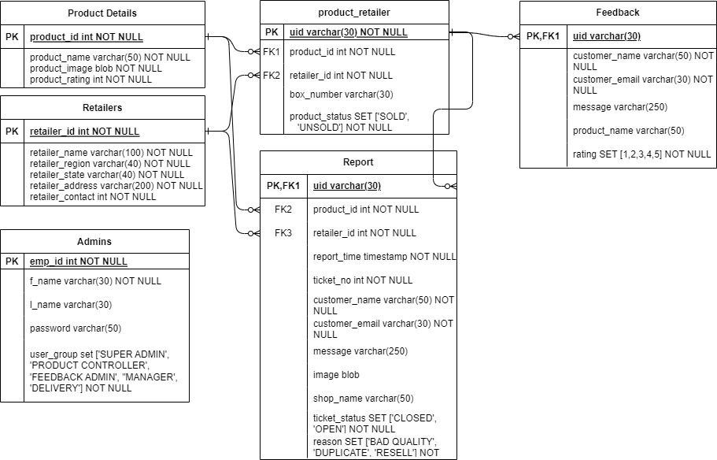
ER Diagram

Slide 9
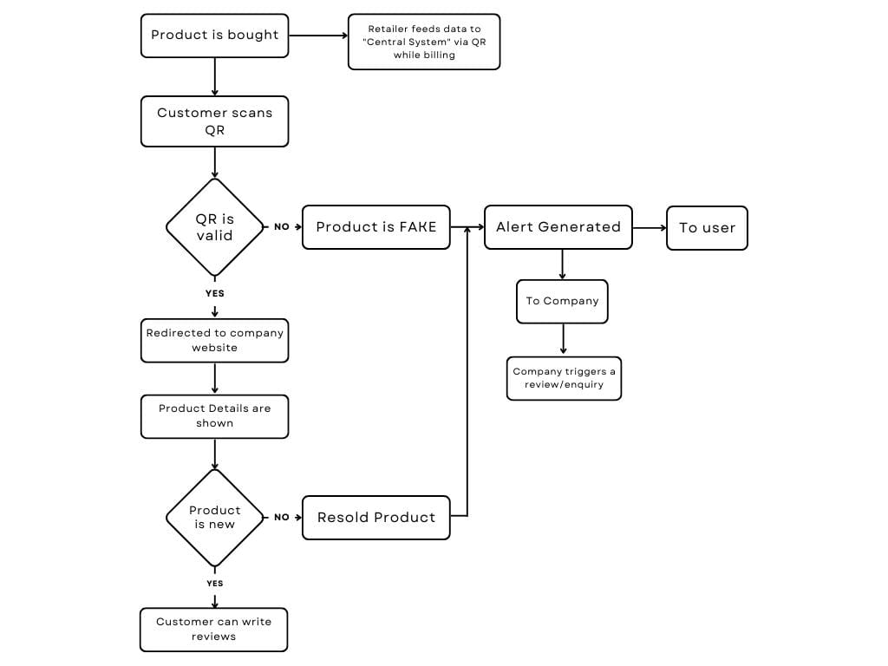
Process Flow Diagram

Slide 10
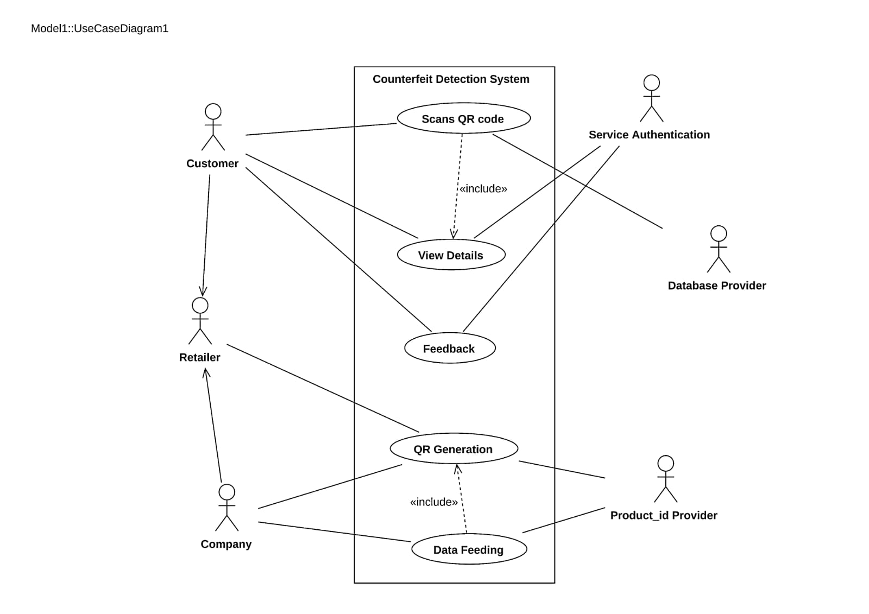
Use Case Diagram

Slide 11
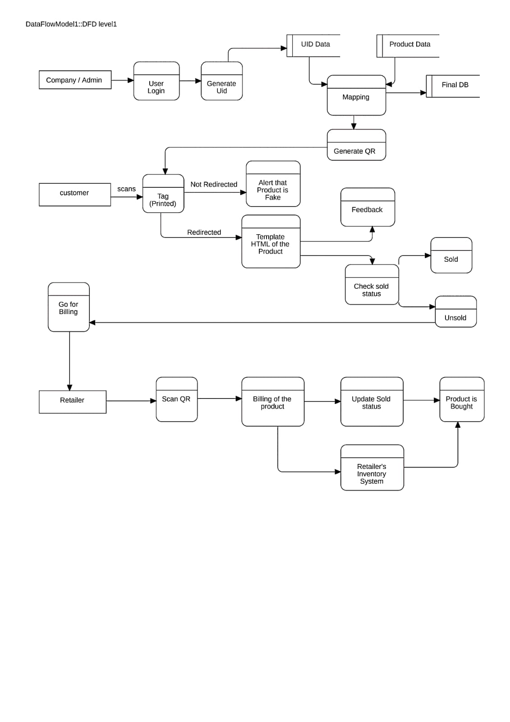
Data Flow Diagram

Slide 12

Patent Status

Slide 13
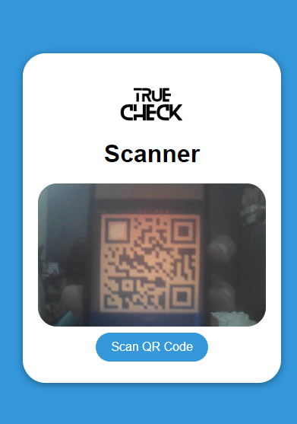
Consumer End

Slide 14
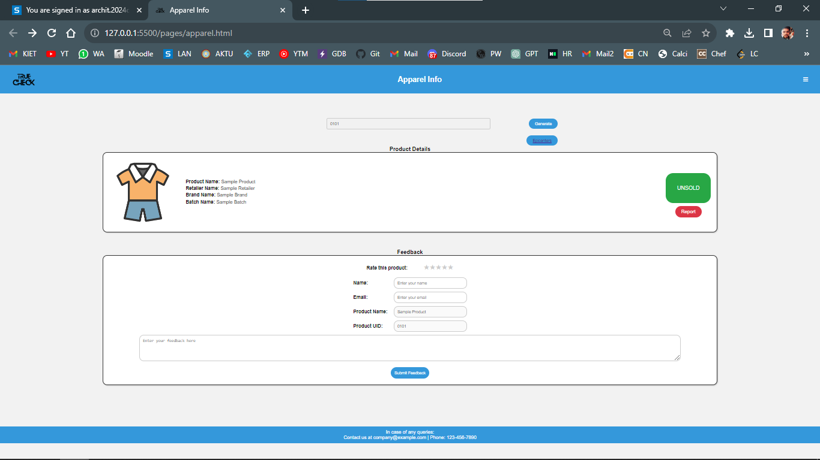

Slide 15
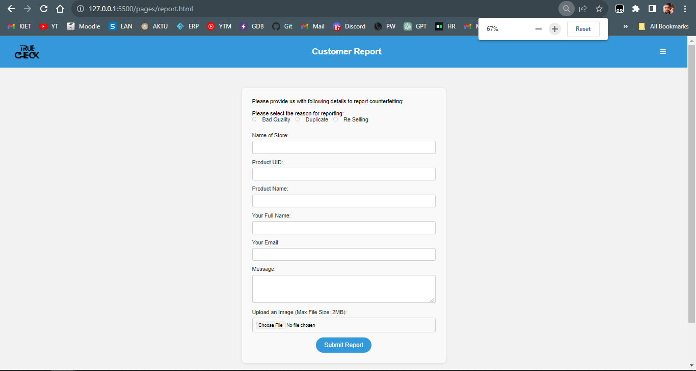
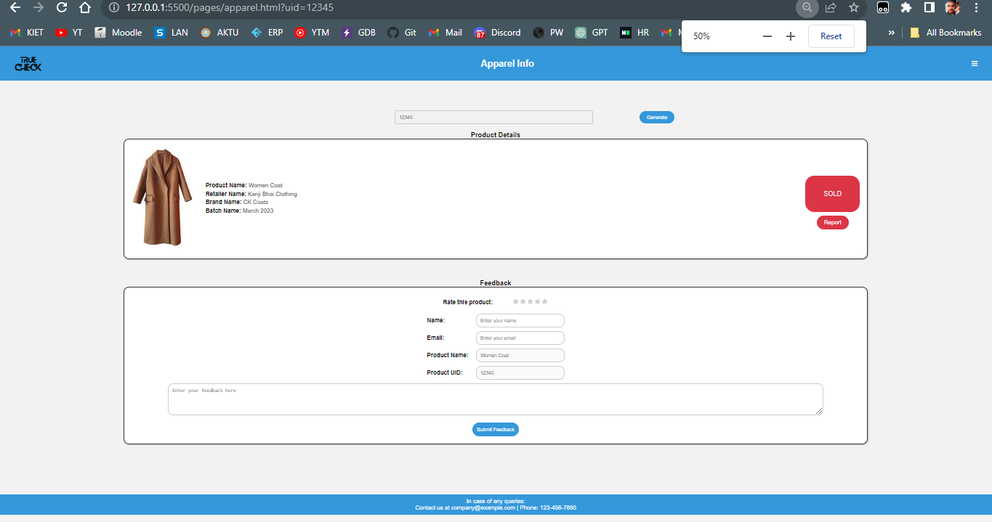

Slide 16
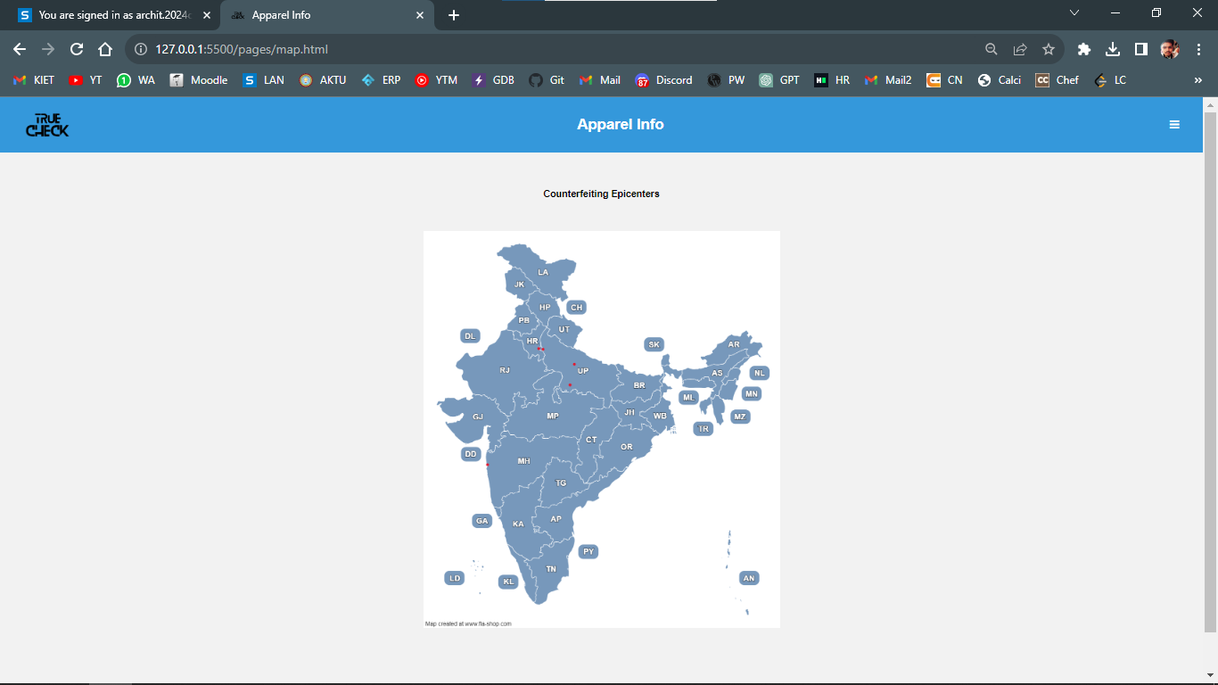

Slide 17
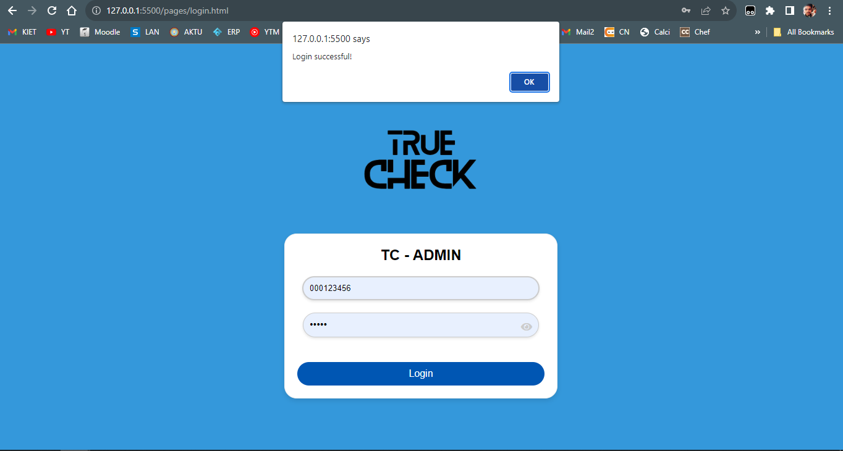
Company End

Slide 18
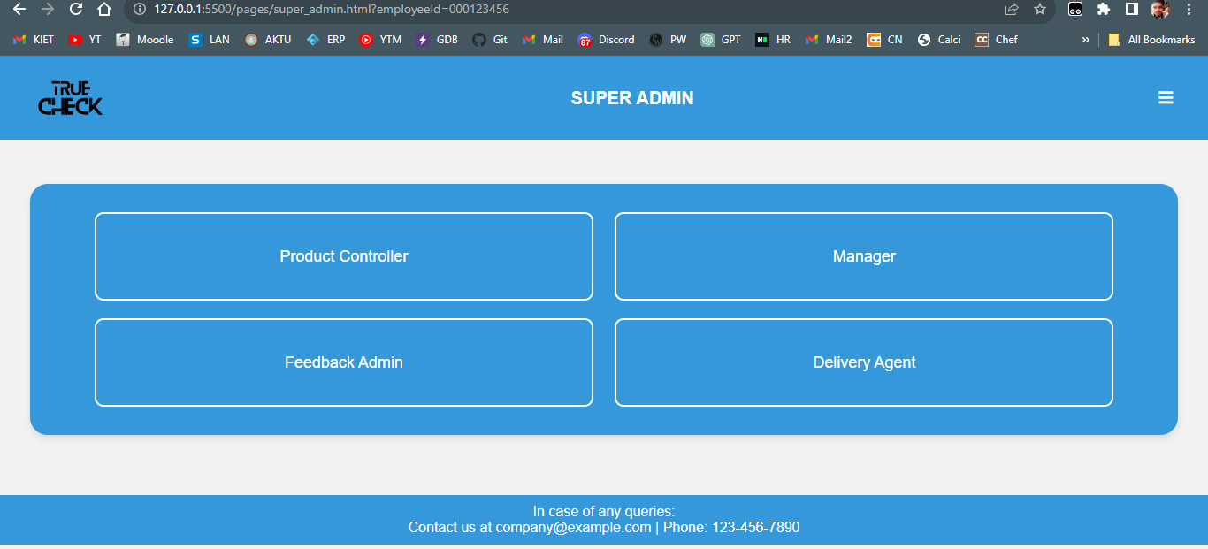
SuperAdmin Screen

Slide 19
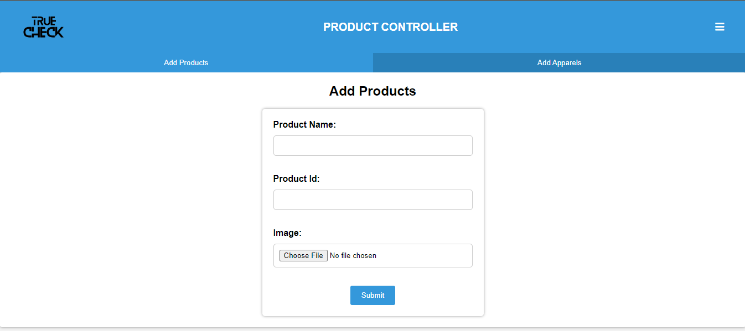
Product Controller Screen 1

Slide 20
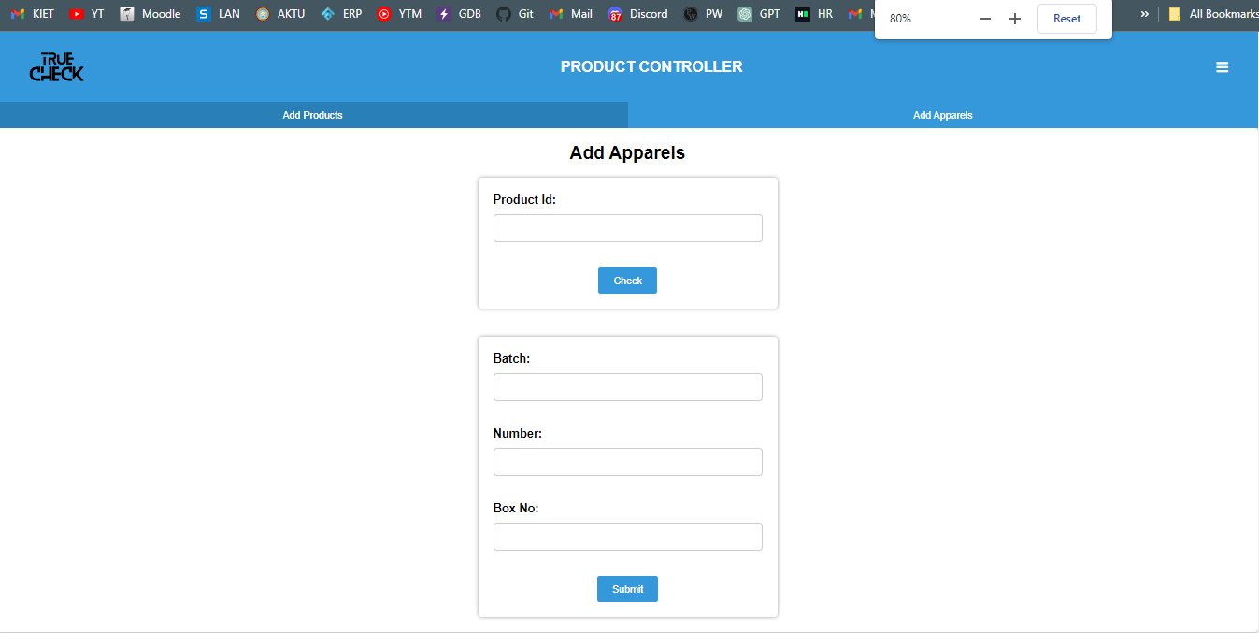
Product Controller Screen 2

Slide 21
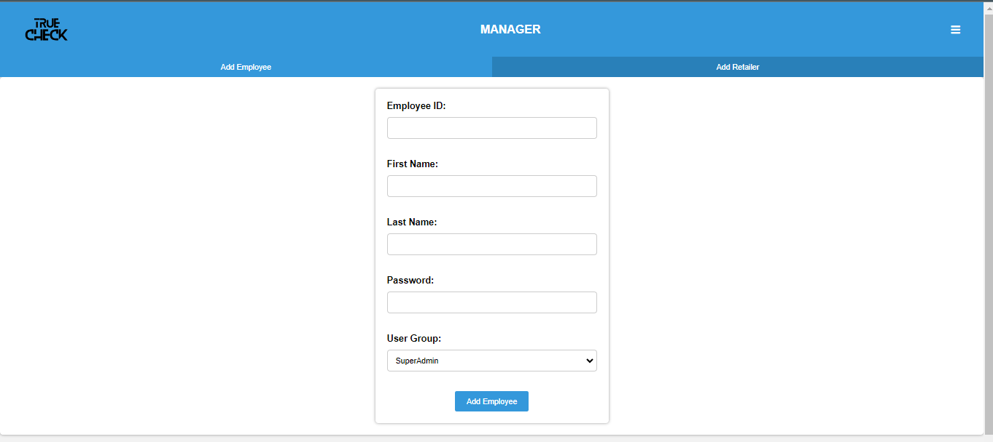
Manager Screen 1

Slide 22
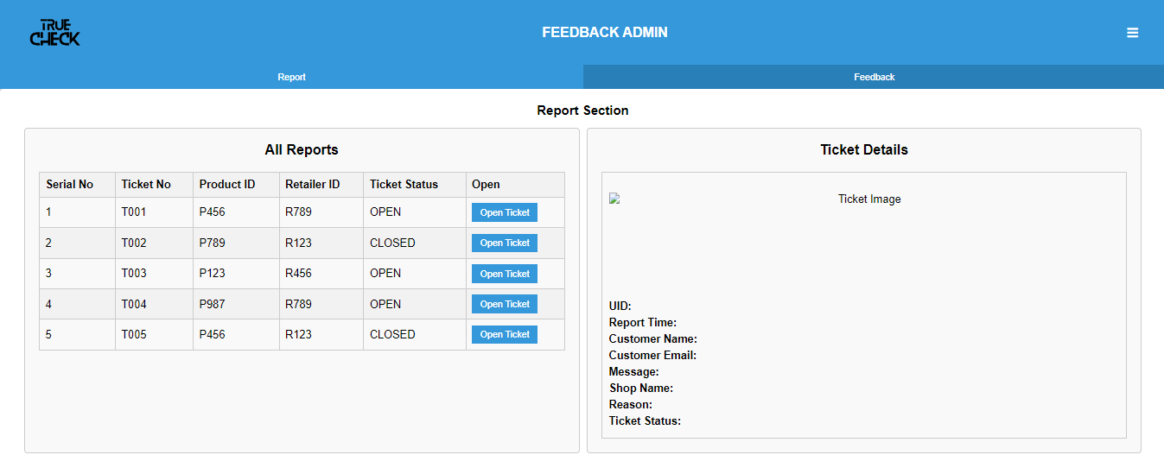
Feedback Admin Screen 1

Slide 23
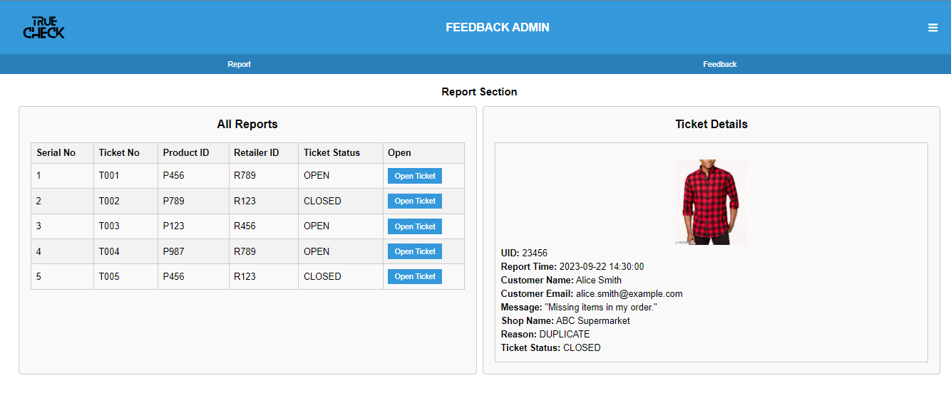
Feedback Admin Screen 2

Slide 24
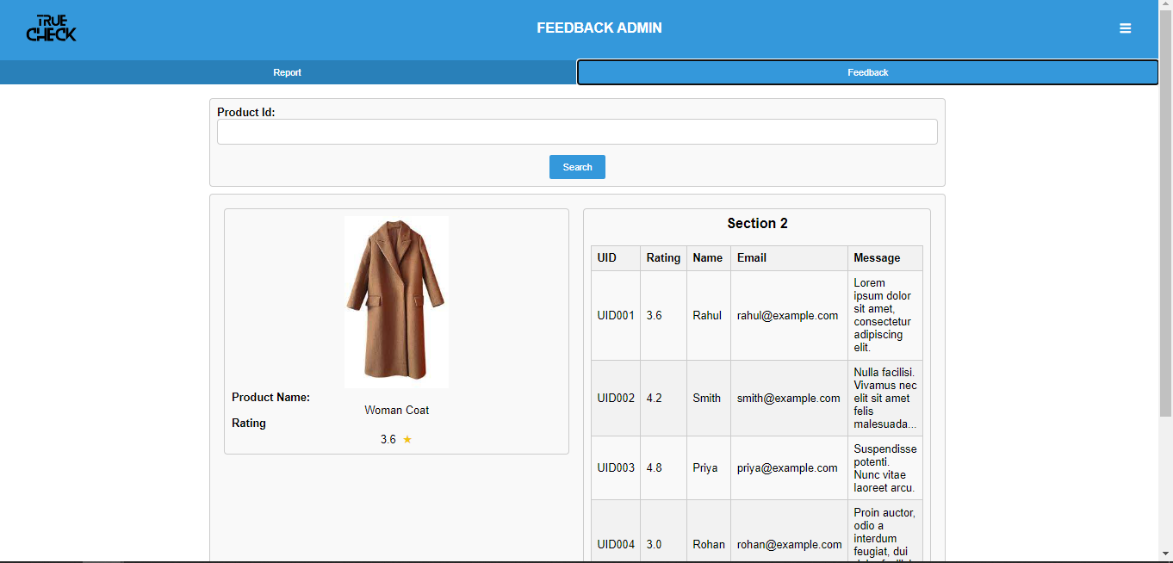
Feedback Admin Screen 3

Slide 25
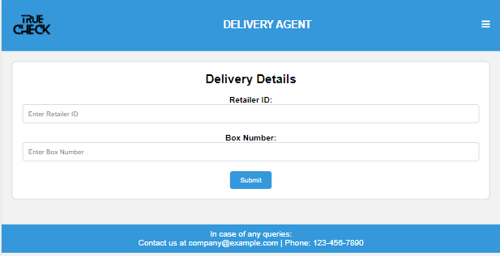
Delivery Agent

Slide 26


Delivery Agent
Admin Error Page
Other Errors

Slide 27
References
An introduction to QR code technology
S Tiwari
2016 international conference on information technology (ICIT), 2016
A STUDY ON COUNTERFEIT BRANDS, CONSUMER ATTITUDE AND INITIATIVES TO STOP COUNTERFEITING IN INDIA AD VALOREM - Journal of Law: Volume 5: Issue II: April - June 2018: ISSN : 2348-5485
Counterfeit detection with qr codes
J Picard, P Landry, M Bolay
Proceedings of the 21st ACM Symposium on Document Engineering, 2021

